Slide 1
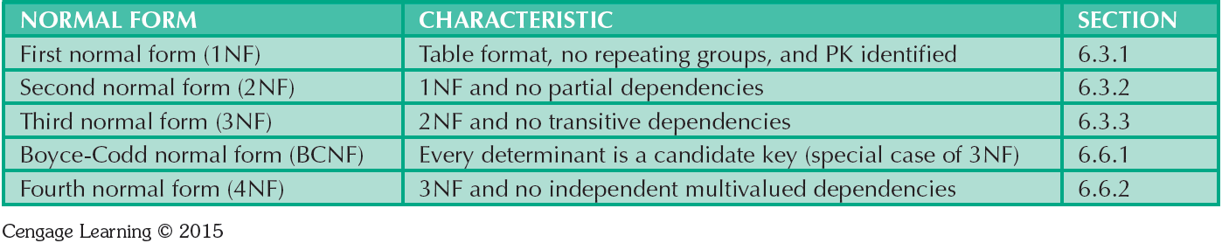
Table 6.2 - Normal Forms

Slide 2
Functional Dependence Concepts
Concept | Definition
Functional dependence | The attribute B is fully functionally dependent on the attribute A if each value of A determines one and only one value of B.
Functional dependence (Generalized definition) | Attribute A determines attribute B if all of the rows in the table that agree in value for attribute A also agree in value for attribute B.
Fully functional dependence (composite key) | If attribute B is functionally dependent on a composite key A but not on any Subset of that composite key, the attribute B is fully functionally dependent on A.

Slide 3
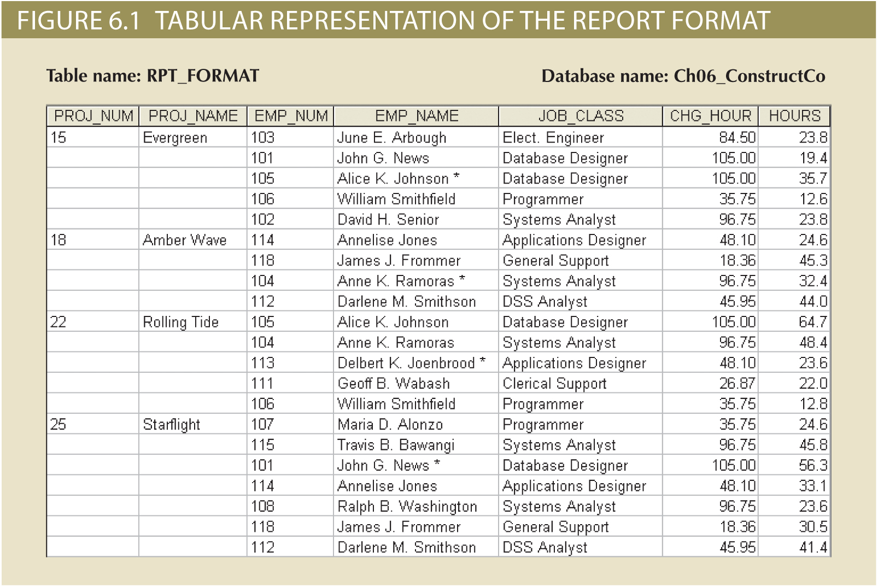

Slide 4
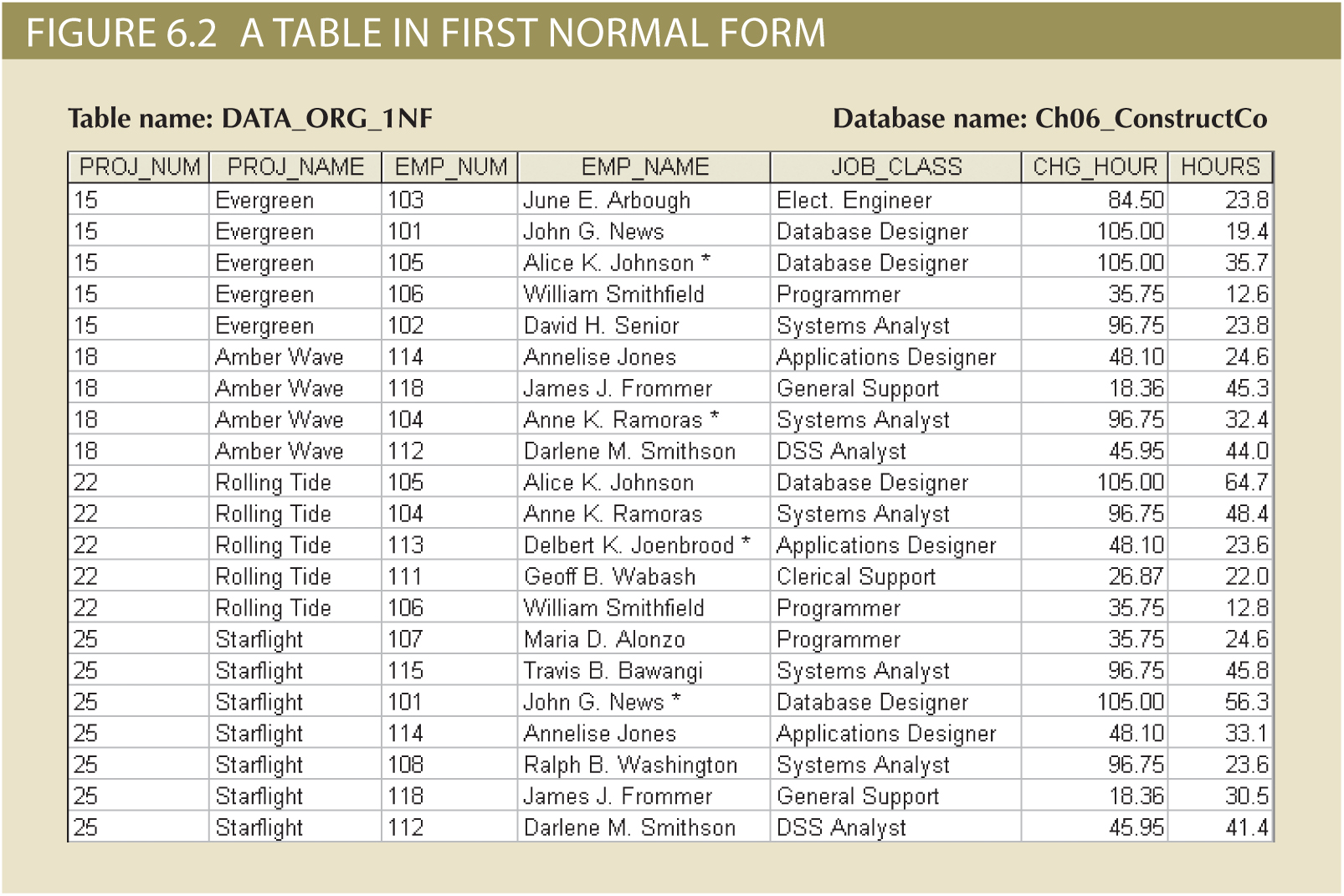

Slide 5
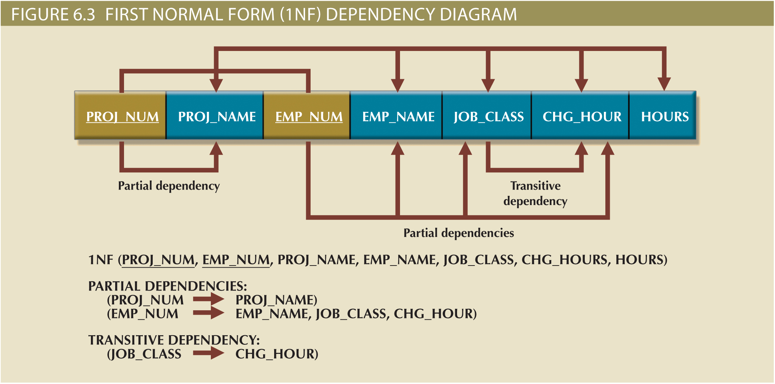

Slide 6
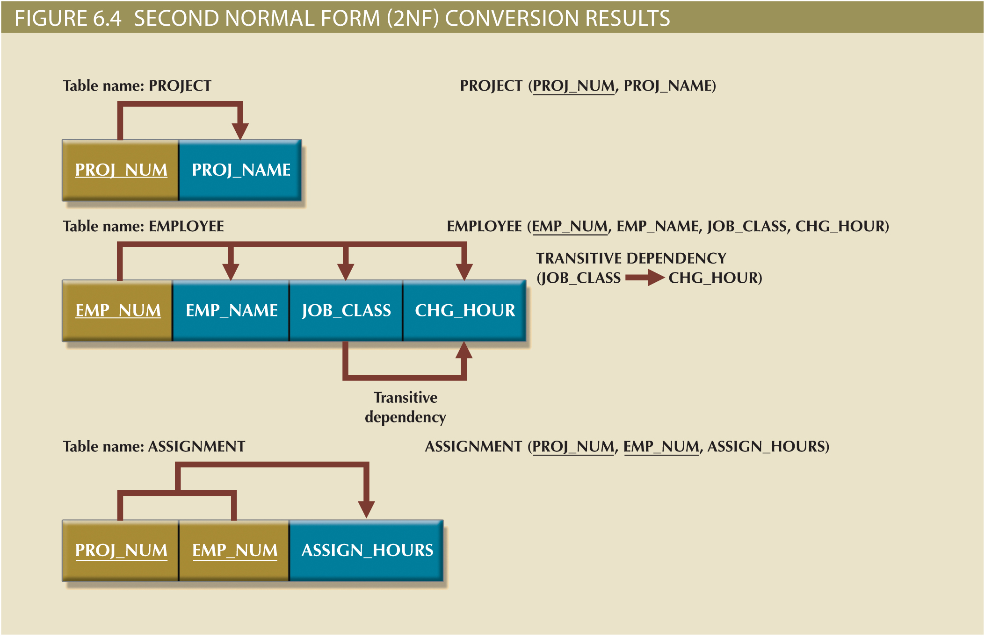

Slide 7
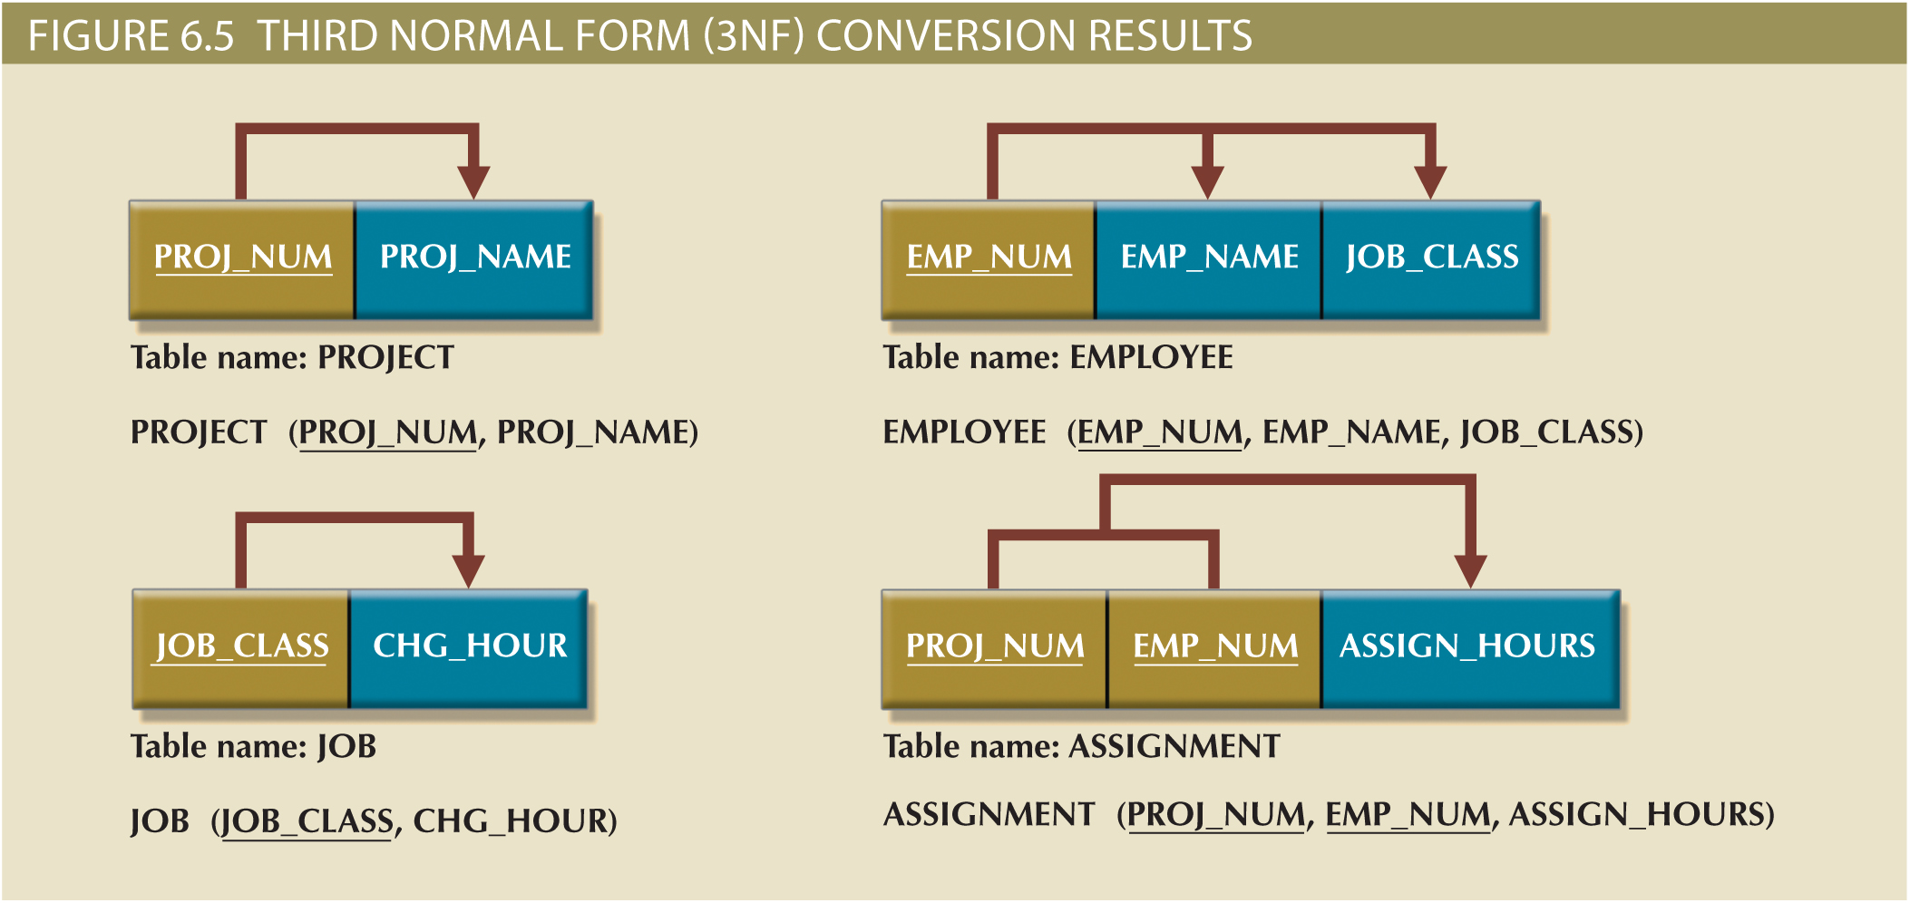

Slide 8
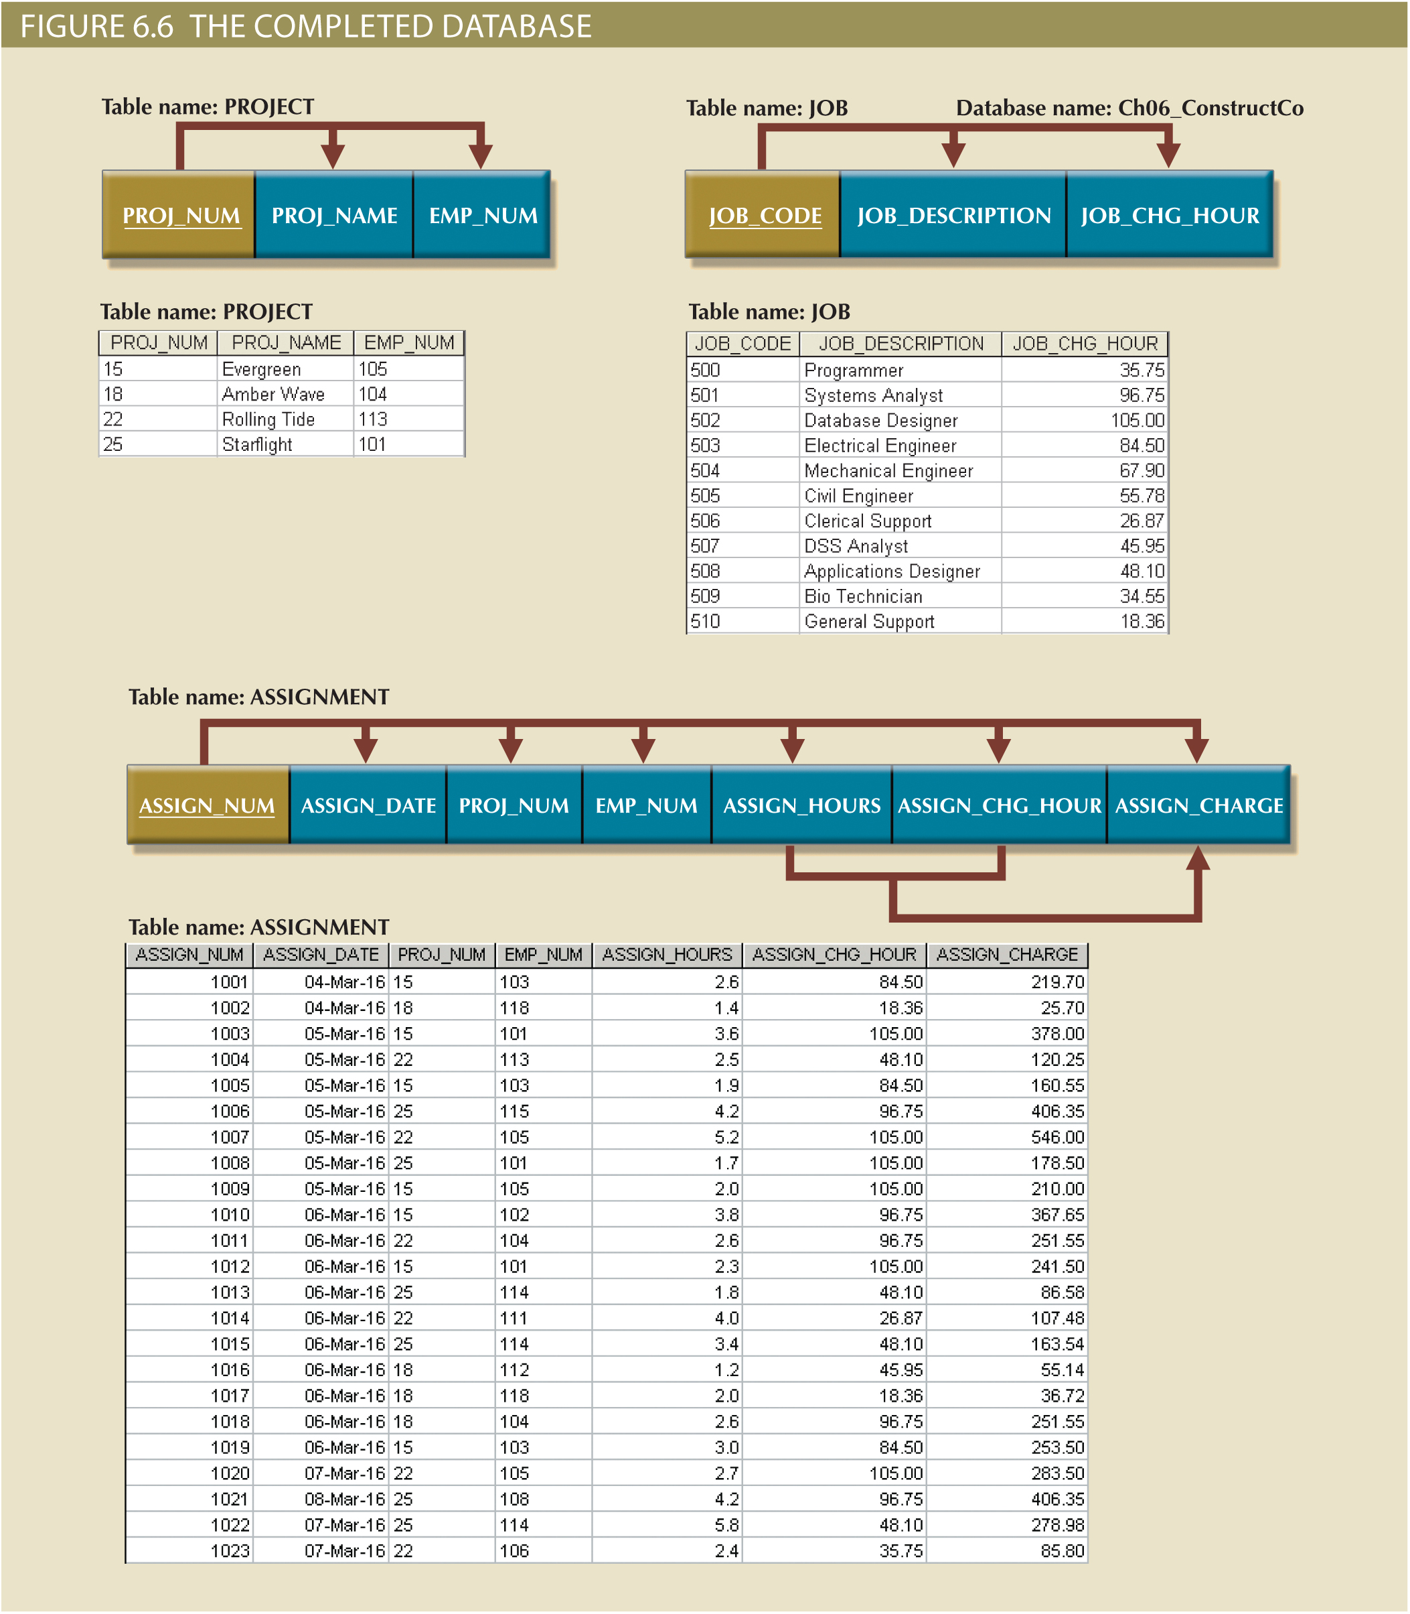

Slide 9
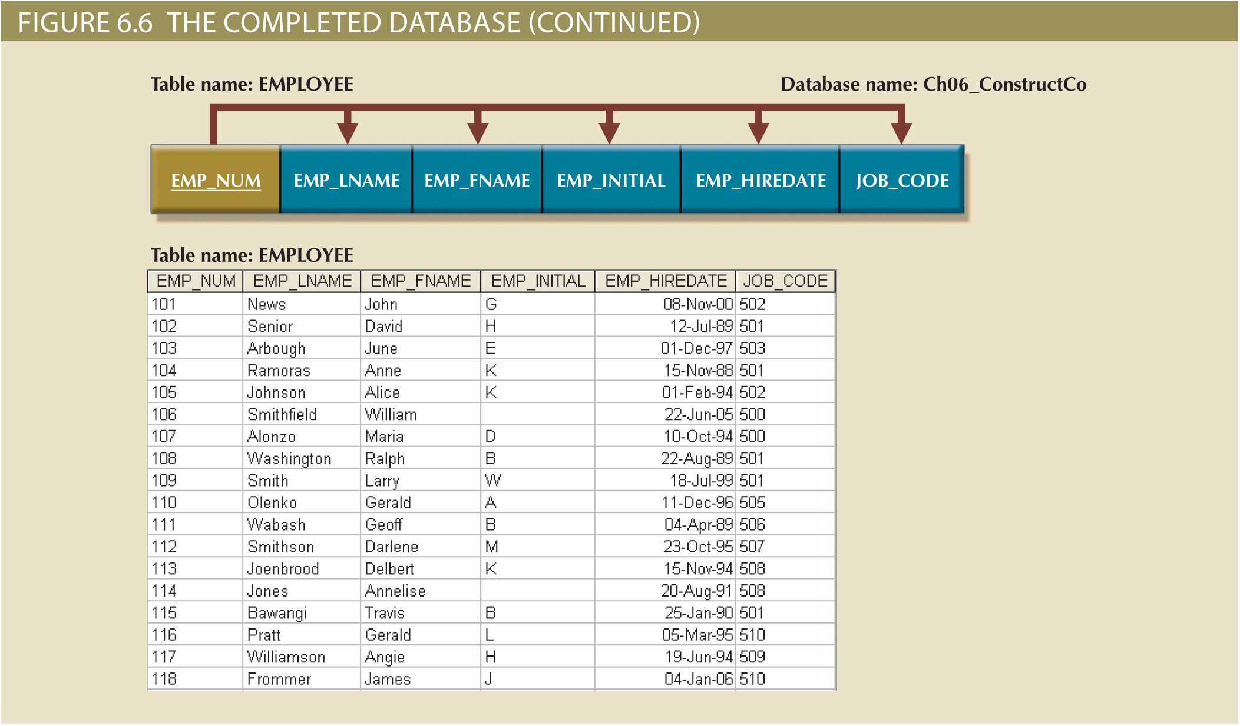

Slide 10
Surrogate Keys
Used by designers when the primary key is considered to be unsuitable
System-defined attribute
Created an managed via the DBMS
Have a numeric value which is automatically incremented for each new row

Slide 11
The Boyce-Codd Normal Form (BCNF)
Every determinant in the table should be a candidate key
Candidate key - Same characteristics as primary key but not chosen to be the primary key
Equivalent to 3NF when the table contains only one candidate key
Violated only when the table contains more than one candidate key
Considered to be a special case of 3NF

Slide 12
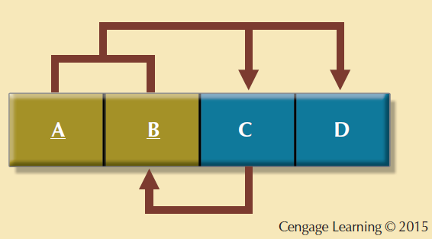
Figure 6.7 - A Table That is in 3NF and not in BCNF

Slide 13
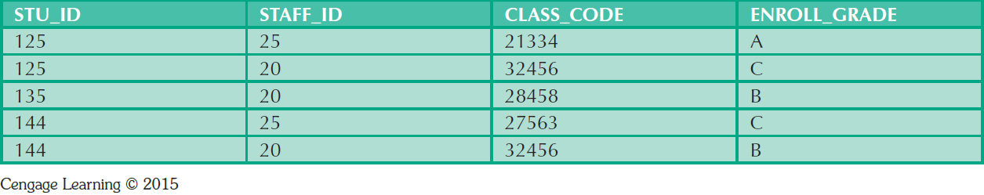
Table 6.5 - Sample Data for a BCNF Conversion

Slide 14
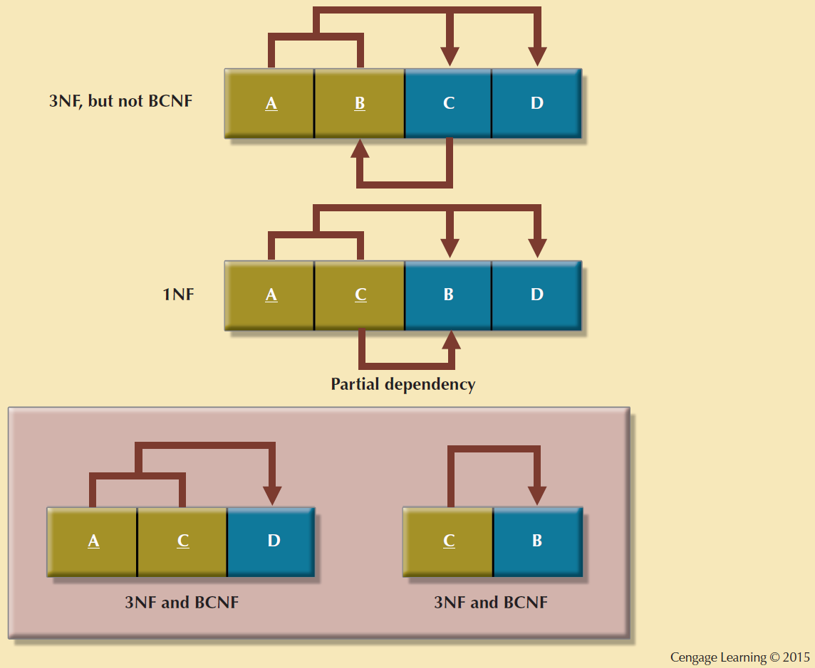
Figure 6.8 - Decomposition to BCNF

Slide 15
Denormalization
Design goals
Creation of normalized relations
Processing requirements and speed
Number of database tables expands when tables are decomposed to conform to normalization requirements
Joining a larger number of tables:
Takes additional input/output (I/O) operations and processing logic
Reduces system speed

Slide 16
Denormalization
Defects in unnormalized tables
Data updates are less efficient because tables are larger
Indexing is more cumbersome
No simple strategies for creating virtual tables known as views

Slide 17
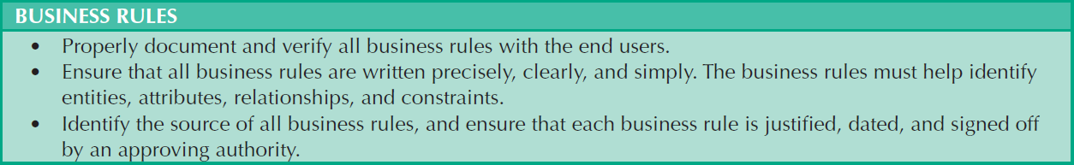
Table 6.7 - Data-Modeling Checklist
Cengage Learning © 2015

Slide 18
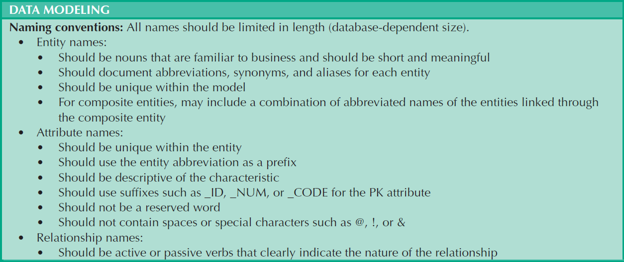
Table 6.7 - Data-Modeling Checklist
Cengage Learning © 2015

Slide 19
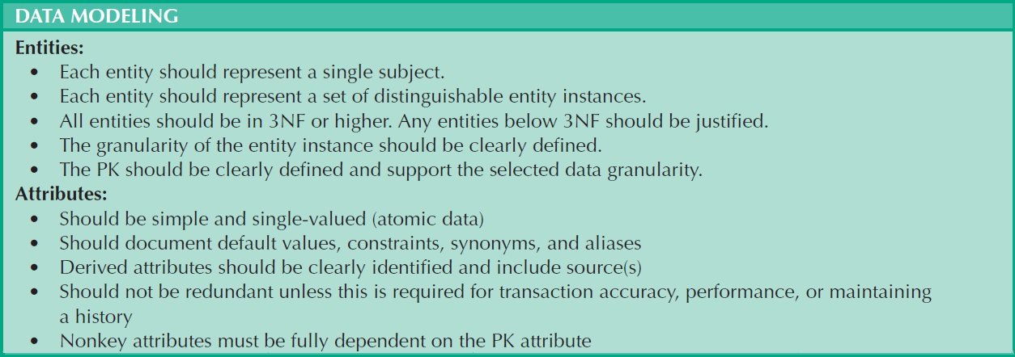
Table 6.7 - Data-Modeling Checklist
Cengage Learning © 2015

Slide 20
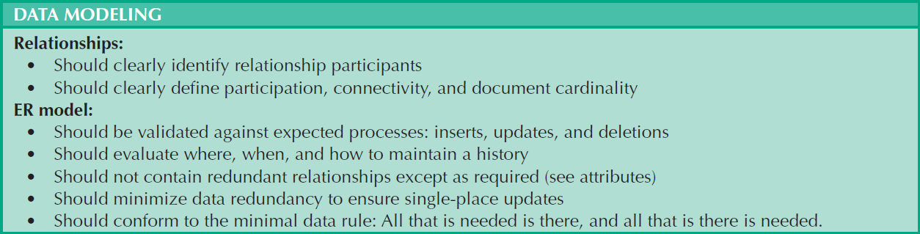
Table 6.7 - Data-Modeling Checklist
Cengage Learning © 2015

